Slide 1
THE FIRST
LOGISTICS SUPER PLATFORM
Automate your Freight
$12.58M
Funding
To-Date
9
Connected
Platform
75%
Current Mobile Adoption
11,800
Carriers Onboarded
7K
Active
Carriers
250+
SMB + Enterprise Customers
$1.2T
Market
Size
www.zuumapp.com

Slide 2
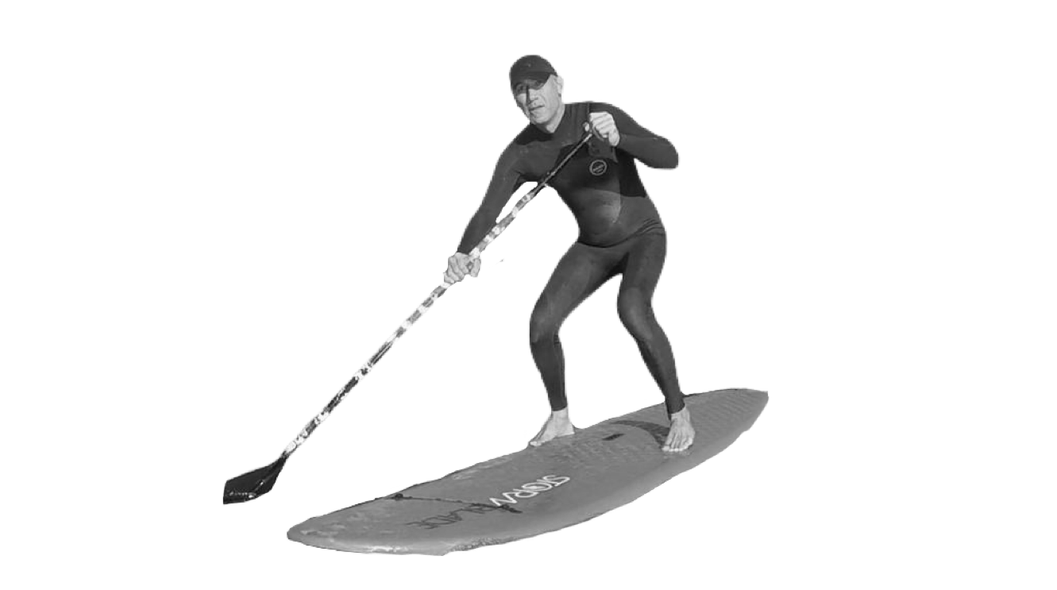
TEAM
Ali Navid
CTO
15 years CTO exp.
Mustafa Azizi
CEO
12 years transport
brokerage
Matt Tabatabai
COO
15 years marketplace/ oem

Slide 3
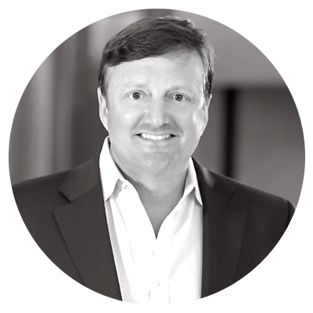
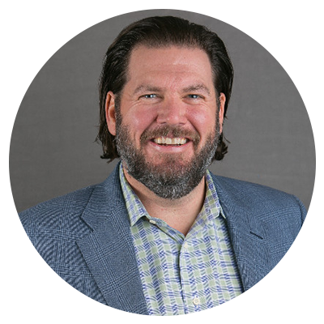
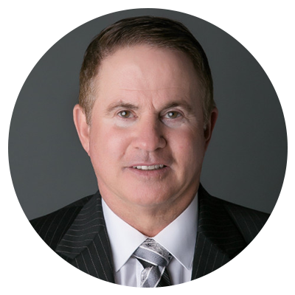
INDUSTRY BACKED - CORPORATE INVESTORS
Daniel White
SVP Strategy Initiatives
Coca Cola Co.
Investor & Advisor
Top 10 USA shipper
Dan Curtis
President
BNSF Logistics
Investor & Advisor
$900M revenue
Top 10 USA Brokerage
Rob Estes Jr.
CEO and Owner
Estes Express Lines
Investor & Advisor
Estes $3.5B revenue
Largest US Private fleet
9000 Trucks +
Pat Martin
VP - Corporate Sales & Strategic Planning
Estes Express Lines
Investor & Advisor
Trucking Company
30,000 employees
Isaac Larian
CEO
MGA Entertainment
Investor & Advisor
$9.2B revenues
Largest toy shipper
Scott Fisher
CEO
EFW Forwarding
Investor and Advisor
$230M revenues
OTHER INSTITUTIONAL INVESTORS

Slide 4
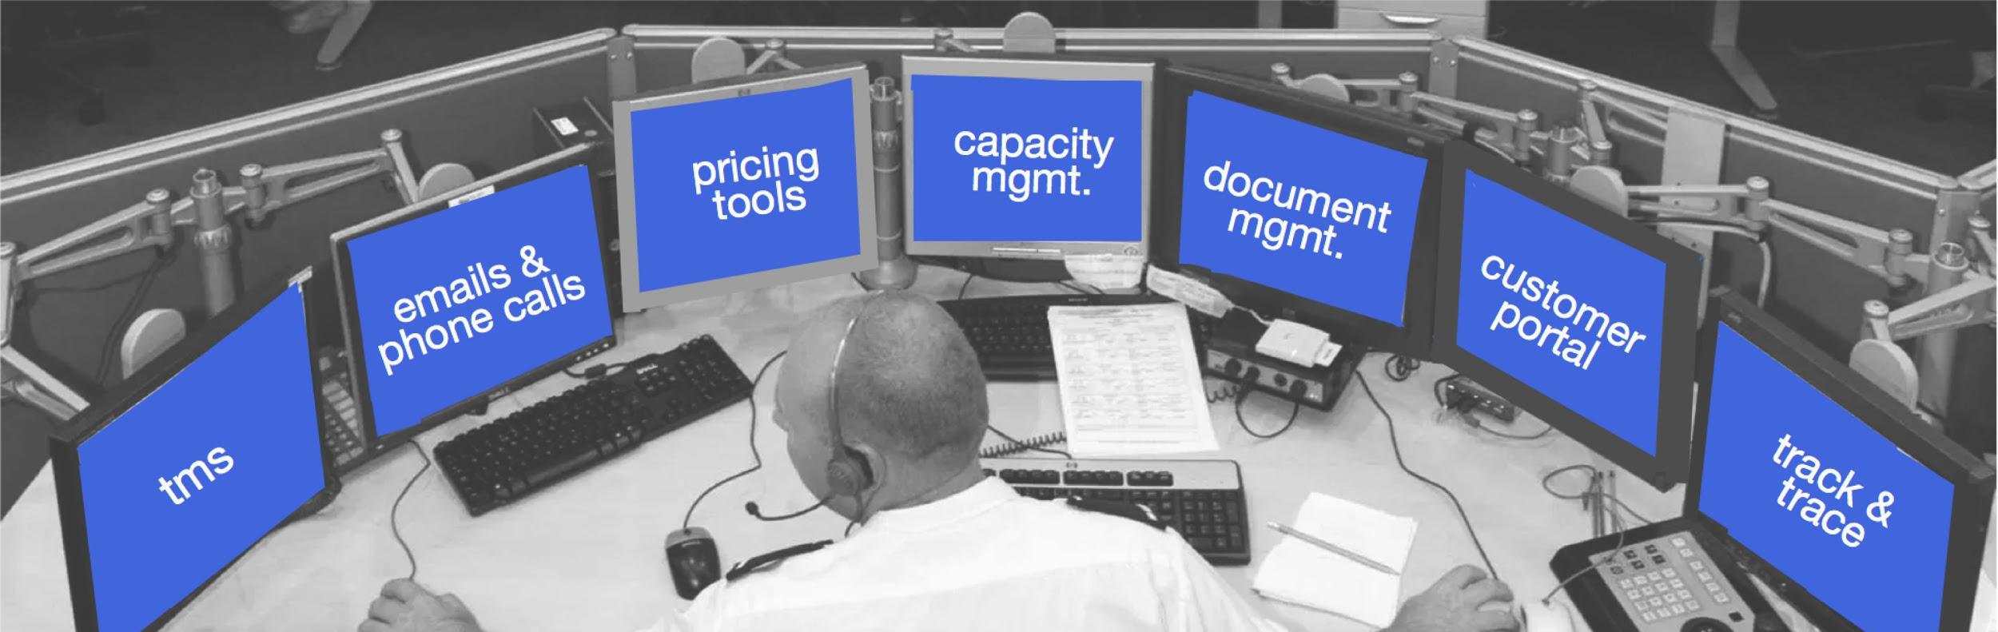
THE PROBLEM - FRAGMENTATION
FRAGMENTED CAPACITY
EDI & Emails
Phone calls & emails
Slow/inefficient
Outdated data-flow
Slow/inefficient
Outdated data-flow
Shipper
Freight Broker
Trucker
FRAGMENTED SYSTEMS
FRAGMENTED DATA FLOW

Slide 5
THE SOLUTION
We’ve identified a white space
COMMISSION
LOW MARGINS
1,000s of traditional brokers
spending millions to digitize
Many digital brokers looking to displace traditional brokers

Slide 6
MARKETPLACE - CAPACITY AGGREGATION & BACKOFFICE AUTOMATION
Digital Freight Marketplace
REVENUE THROUGH COMMISSION
TRANSPARENT BOOKINGS
SHIPPERS
DRIVER

Slide 7
MARKET SIZE
5%
CAGR
TO 2022
$1.2
TRILLION
3.5
MILLION
DRIVERS
$100
BILLION
Saas Market
Freight Market Size

Slide 8
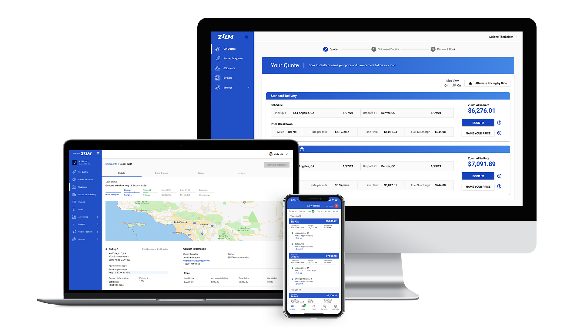
SHIPPERS
12-15%
100%
34-35%
Shipper TMS | Digital Freight Marketplace
average saving
per load
Delivery, 98.7%
service levels
average time
saved
Instant Nationwide Capacity
Optimal Service Level
Reduce Freight Cost
Back-office Automation
Real-time Visibility
Advanced Analytics & Reports
Secure Universal Integration

Slide 9
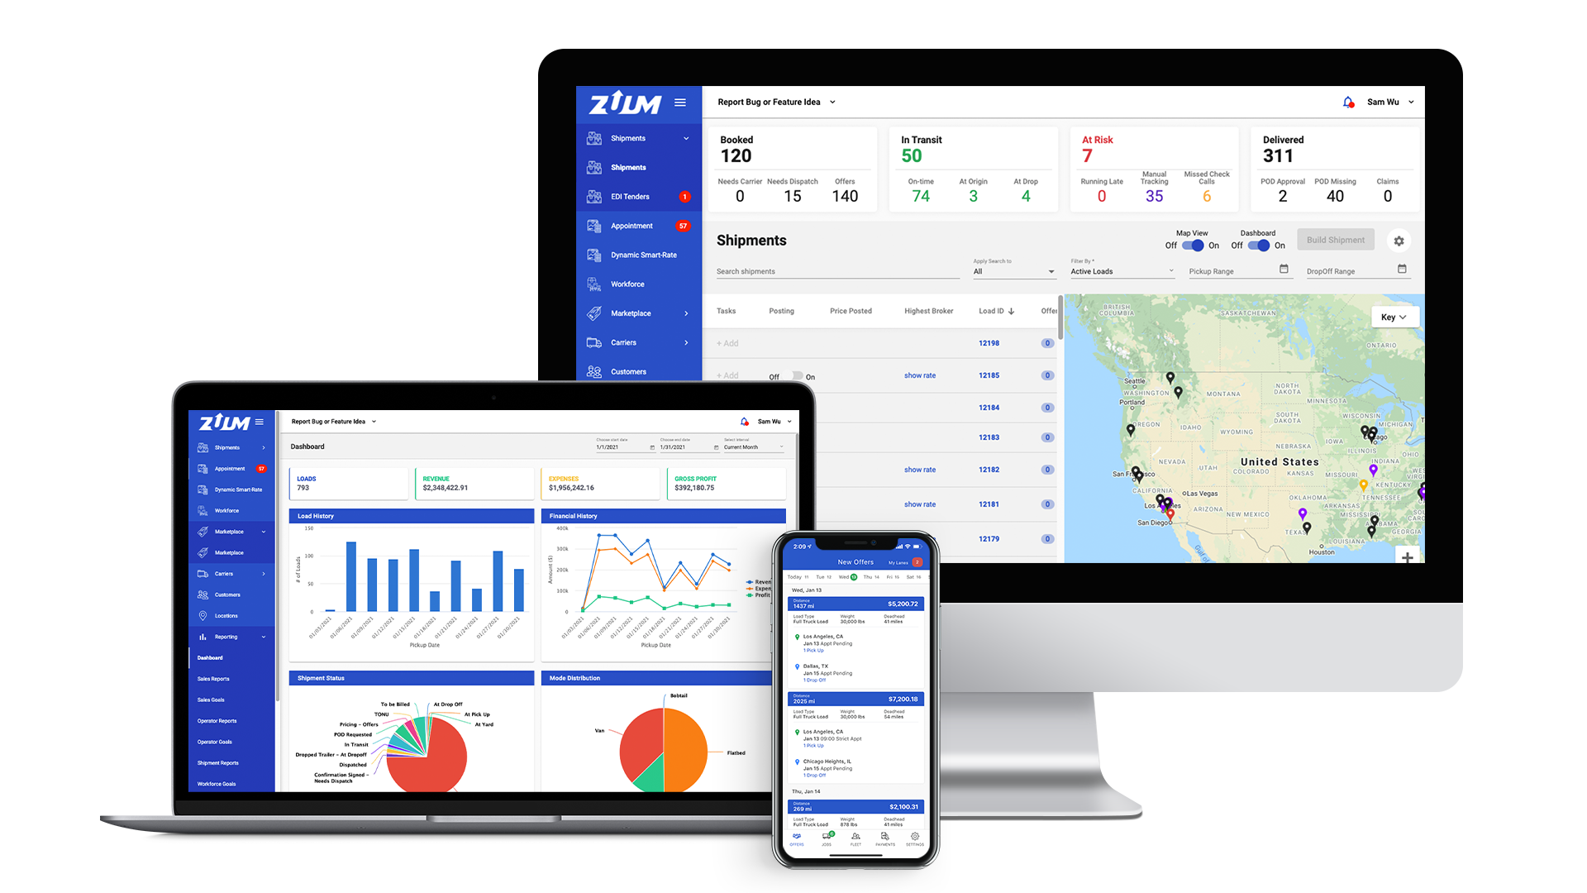
BROKERS
Full Digital Broker in-a-box - First to market
40%
35%
$5M
productivity
increase
faster load
matching
average digitization
cost savings
Automated Load Board Posting & Spot Bidding
Digital Load Tendering & Notifications
Real-time Shipment Visibility
Digital Document Management
Shipper & Carrier Management
Advanced Analytics & Reports
Secure Universal Integration

Slide 10
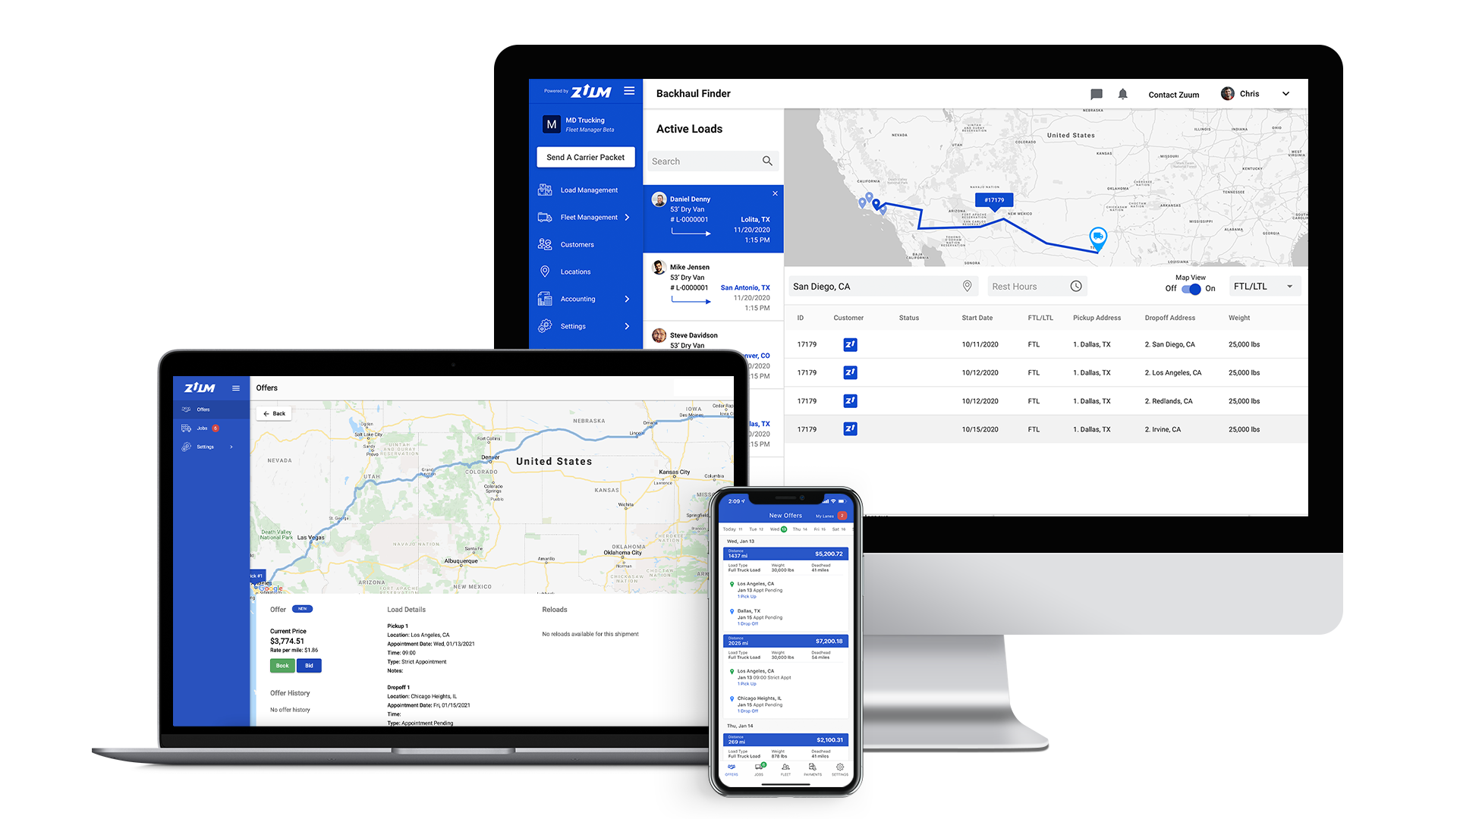
CARRIERS
Carrier TMS & Dispatch System | Driver Mobile App |
Digital Freight Marketplace
480+
2-3 Days
20-30%
shippers we
deliver for
average payment
time
dark capacity
decrease
Find Profitable Loads
Access to Largest Shippers
Get Paid faster
On-Demand Visibility
Driver Profitability Metrics
Advanced Analytics & Reports
Secure Universal Integration

Slide 11
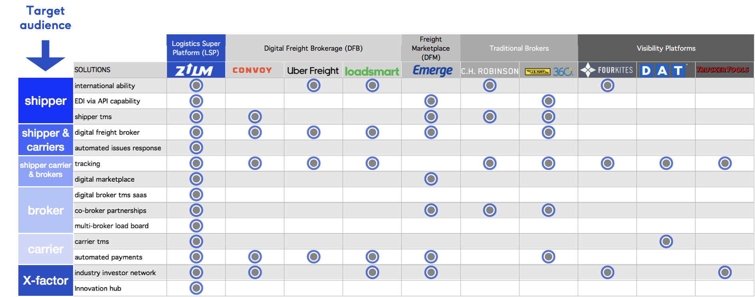
COMPETITIVE MATRIX - THE LOGISTICS SUPER PLATFORM (LSP) REIGNS SUPREME

Slide 12
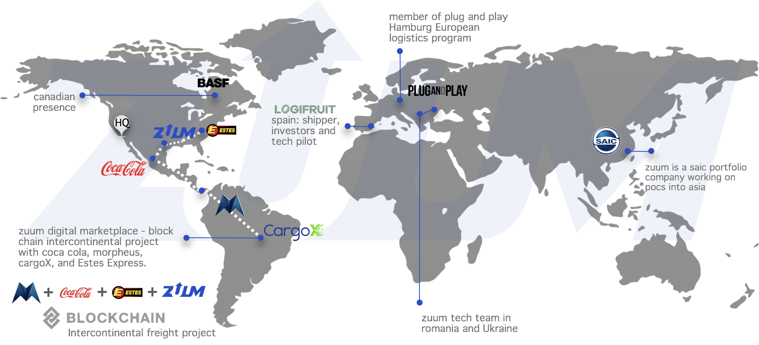
GLOBAL FOOTPRINT

Slide 13
CUSTOMER TRACTION
SHIPPERS
BROKERS
CARRIERS

Slide 14
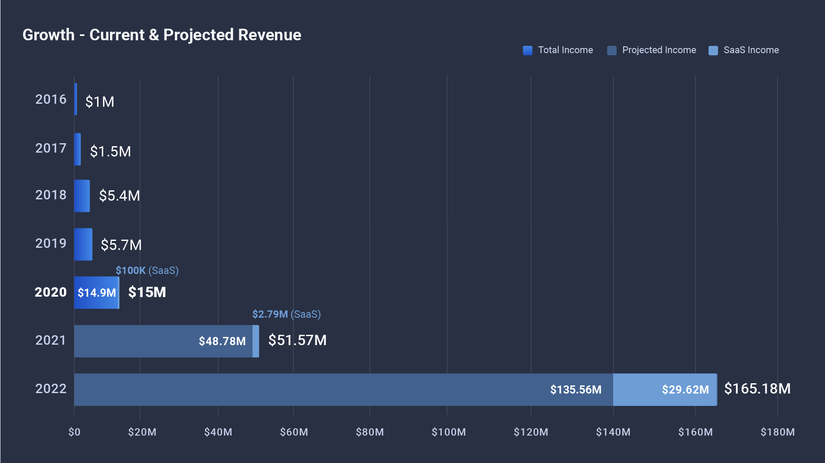

Slide 15
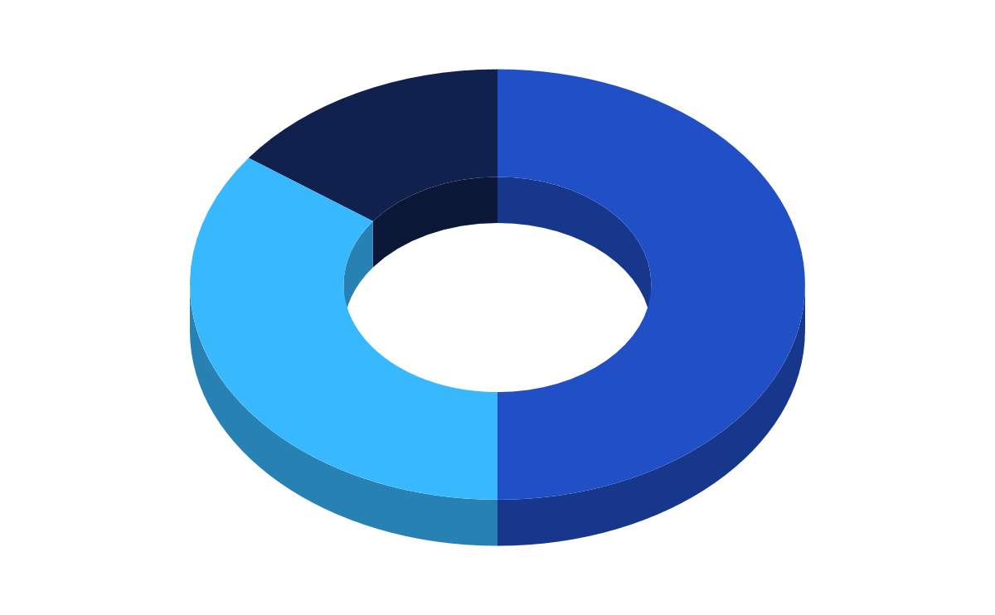
Raising
Use of Funding
$20,000,000
Last Round Closed
Ops & Admin
$8,580,000
Via Safe Note
25M Cap
20% discount
Tech &
Dev
Marketing &
Sales
Total Funding to Date
$12,580,000
Marketing & Sales
50%
Tech & Dev
35%
Ops & Admin
15%
Cash on hand
Runway
$4,300,000
18 mos

Slide 16
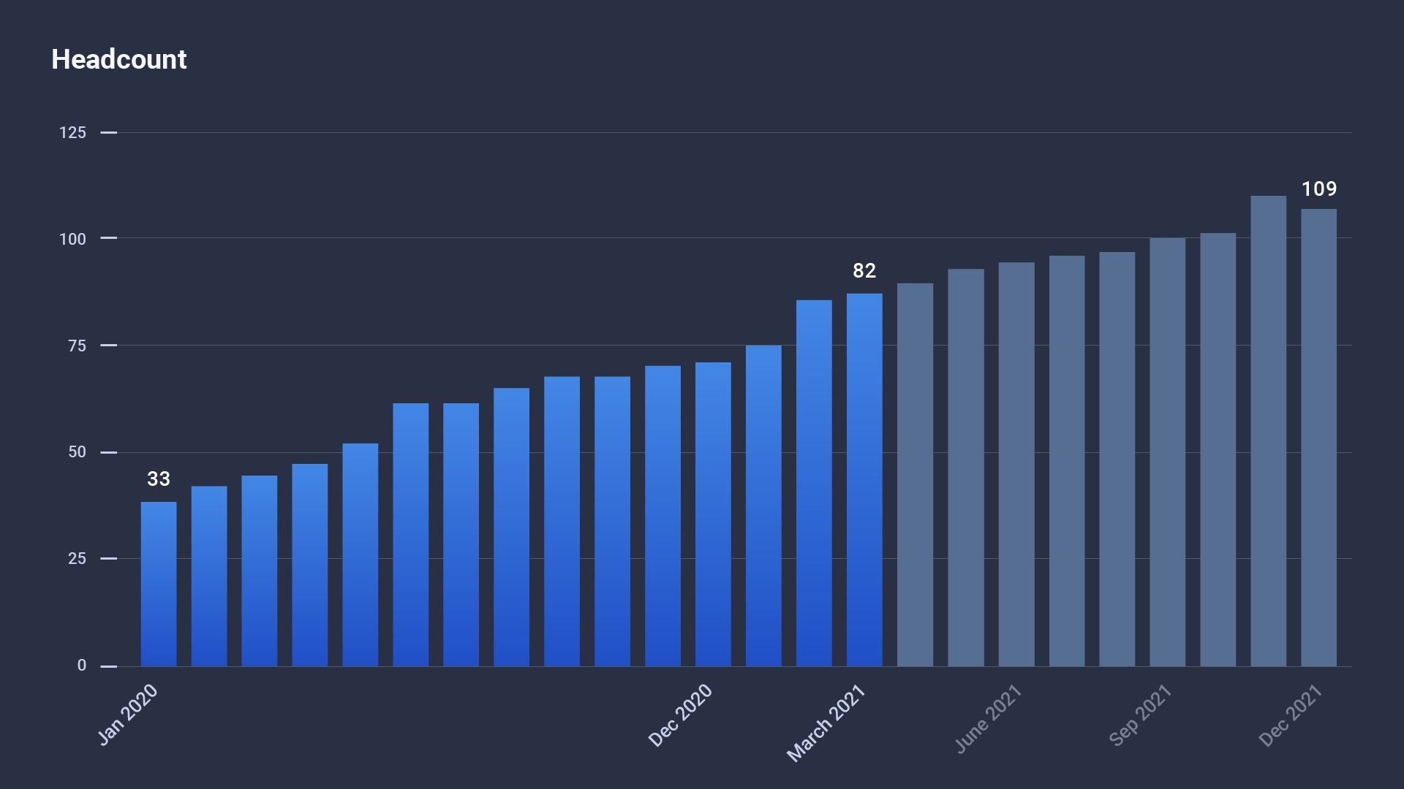
Notes:
headcount

Slide 17
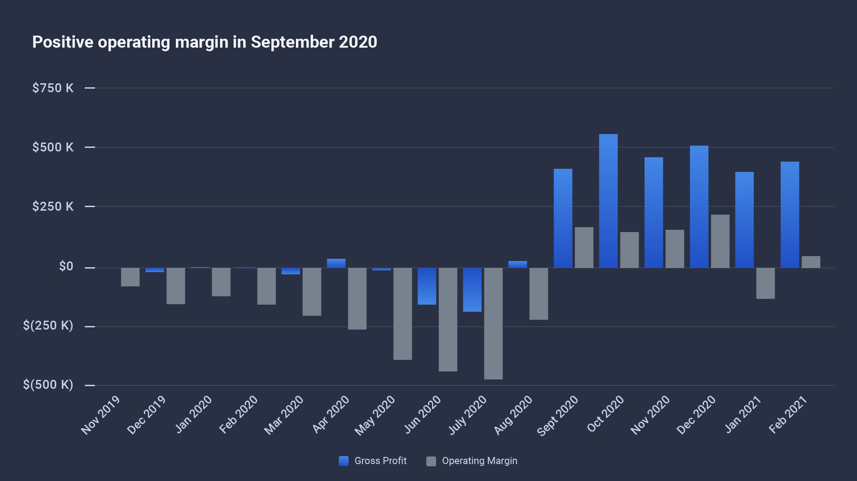
Feb 2021
$423 K
Gross Profits
Feb 2021
$41 K
Operating Margin

Slide 18
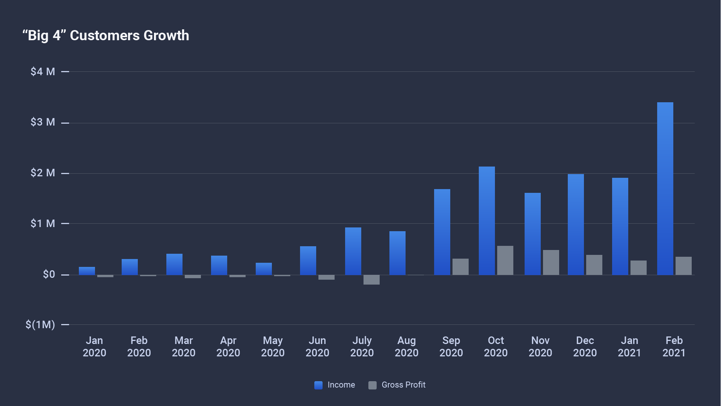
Feb 2021
$3.3 M
Income
Feb 2021
$437 K
Gross Profits

Slide 19
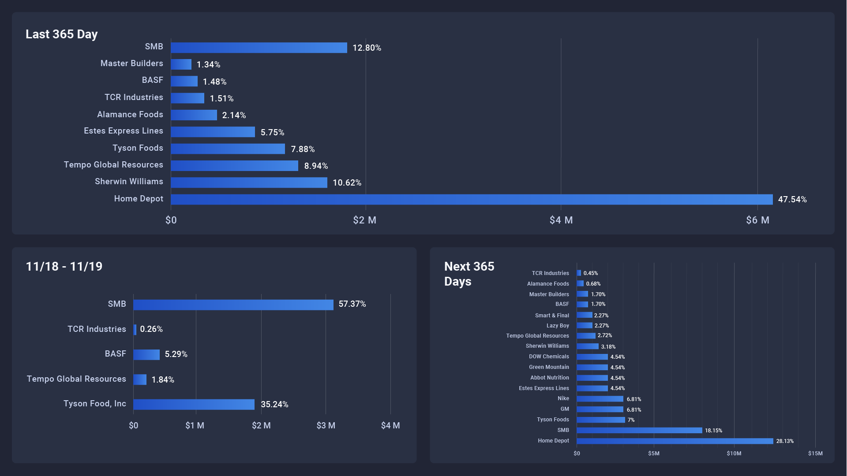

Slide 20
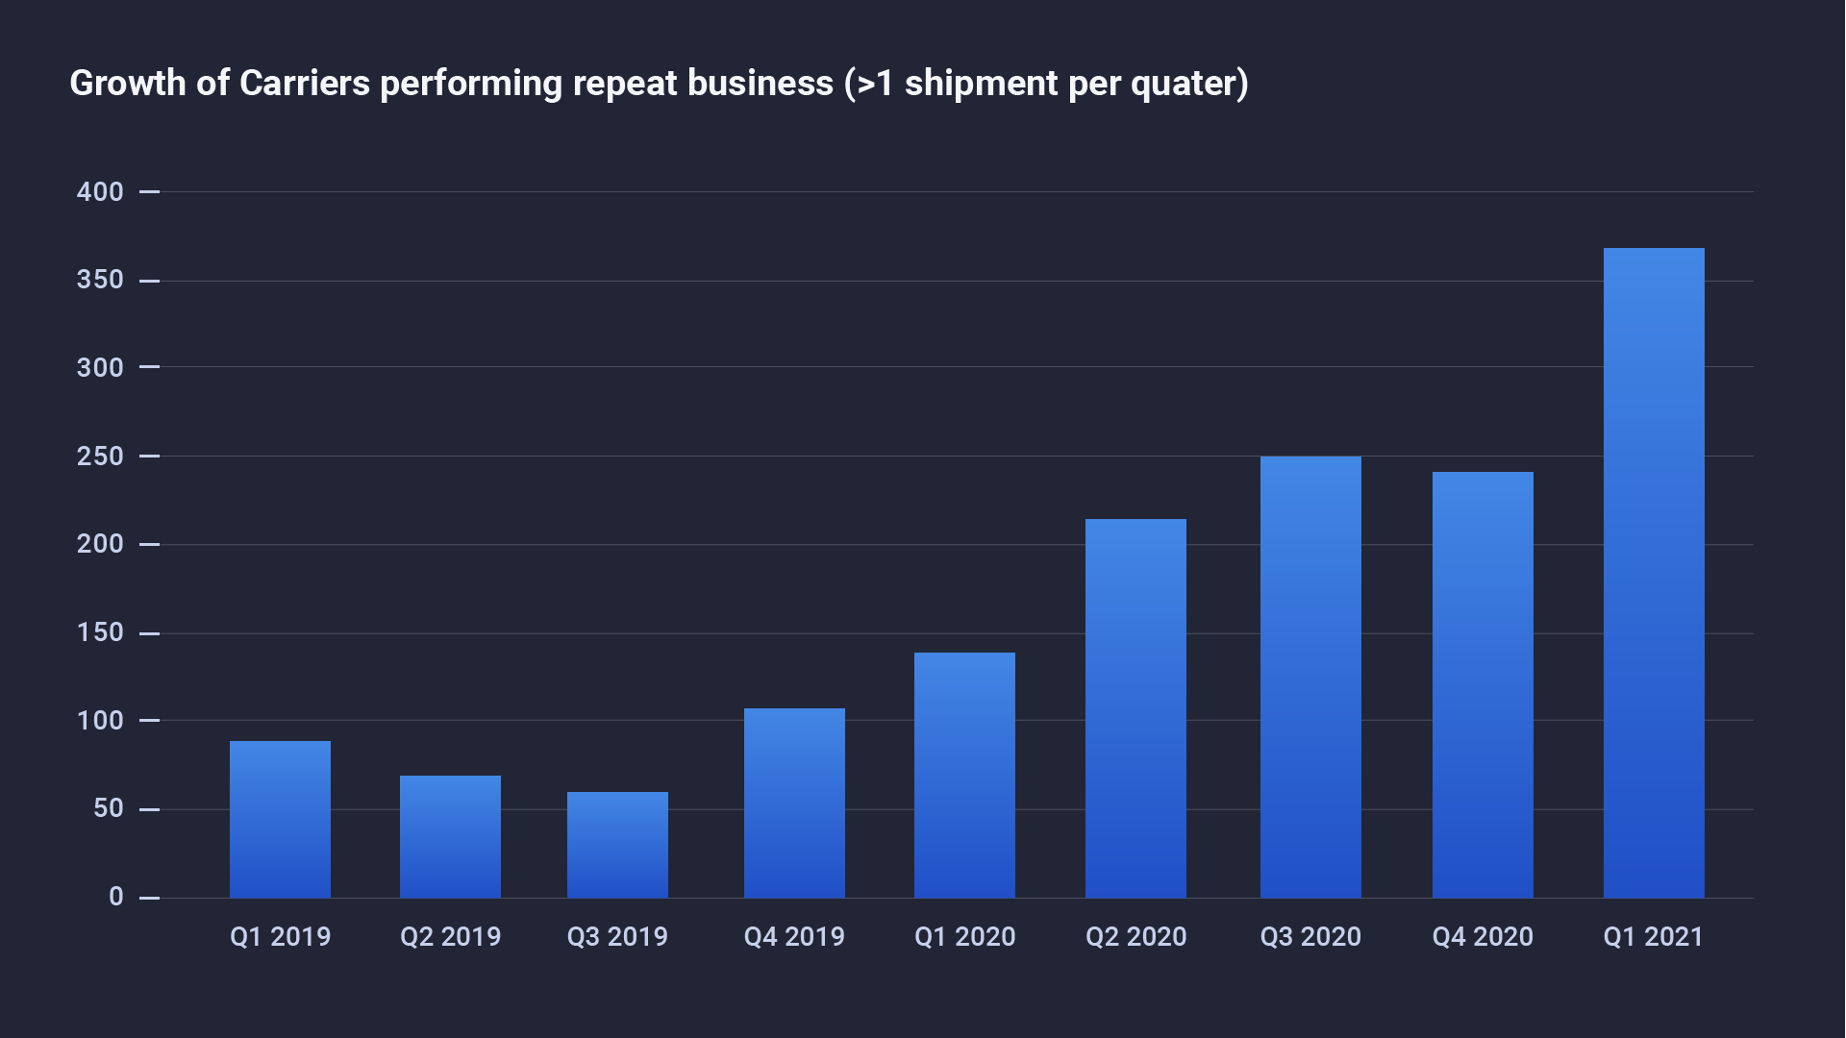
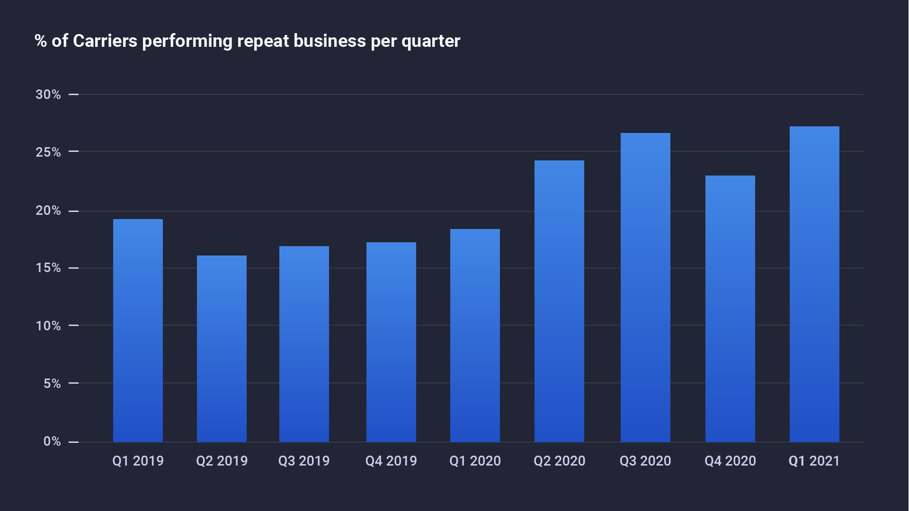

Slide 23
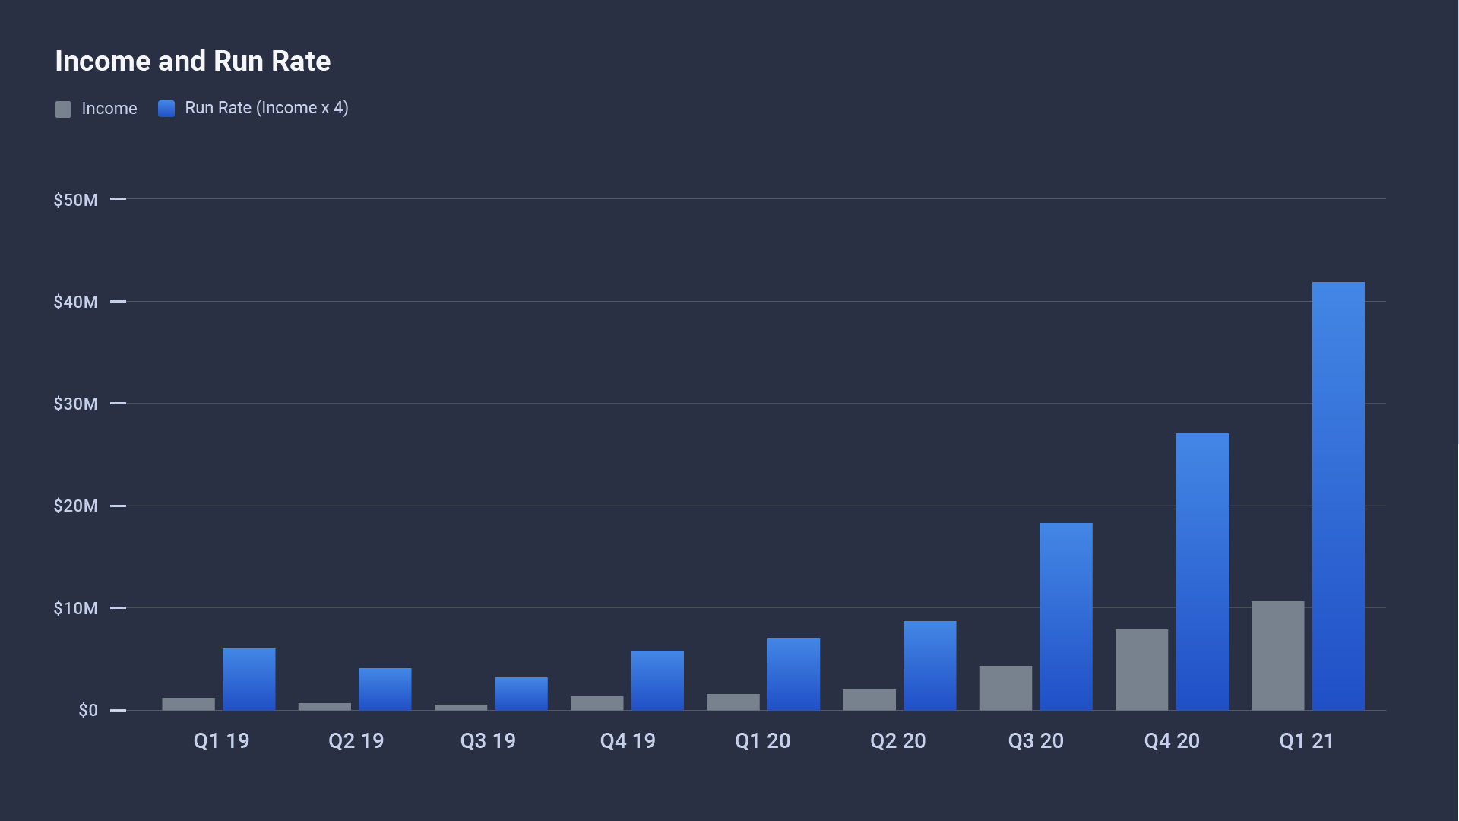
Q1 2021
$10.5 M
Income
Q1 2021
$42 M
Run Rate

Slide 24
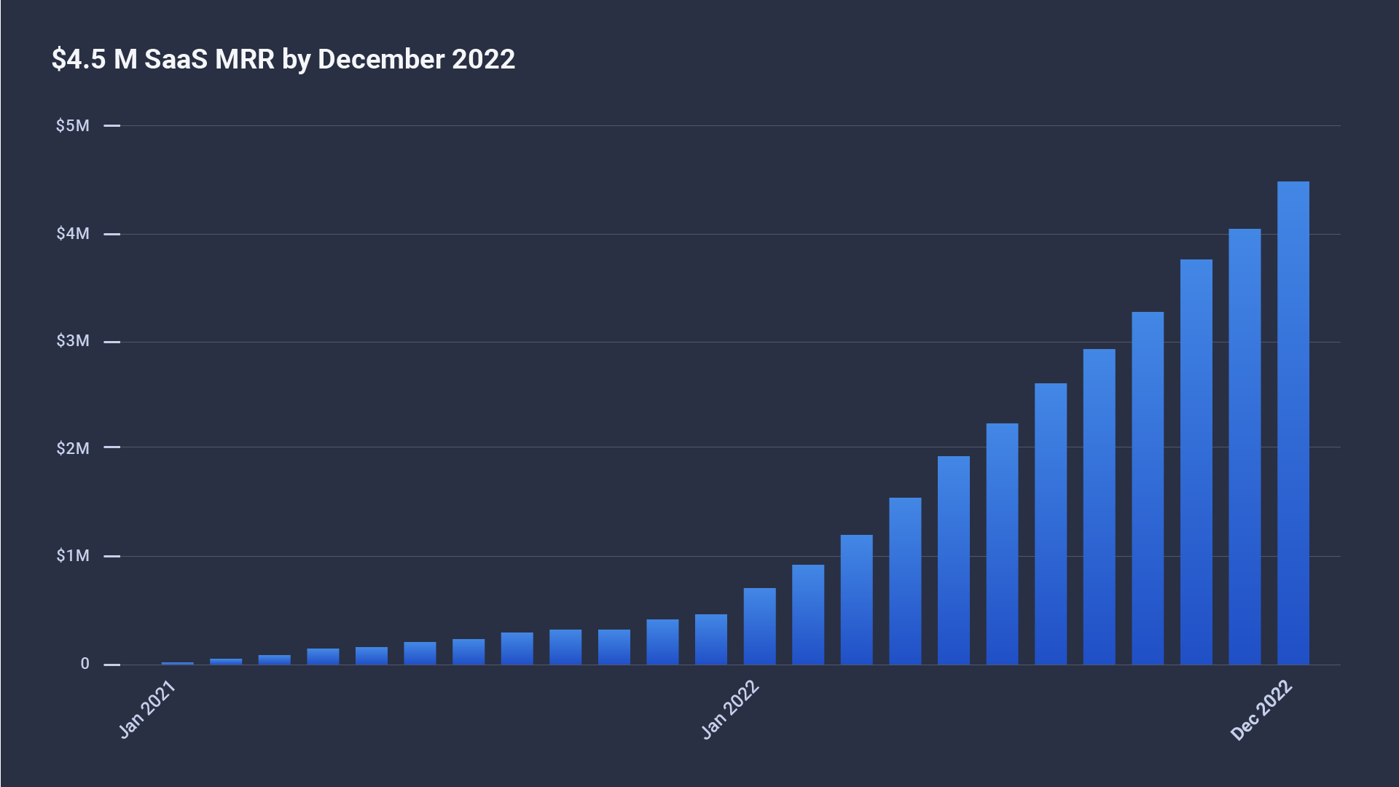

Slide 25
Summarized Proforma
2021
2022
2023
2024
2025
Marketplace Income
SaaS Income
Total Income
COGS
Gross Profit
Total Expenses
Net Income
$ 48,782,472
2,796,446
51,578,918
43,988,118
7,590,800
12,585,975
(4,995,175)
$ 135,561,973
29,624,175
165,186,147
122,894,501
42,291,646
30,171,950
12,119,697
$ 421,706,500
93,424,754
515,131,254
382,338,592
132,792,662
65,343,900
67,448,761
$ 949,763,832
197,868,933
1,147,632,765
860,723,517
286,909,248
108,015,850
178,893,398
$ 2,139,050,114
345,972,755
2,485,022,869
1,935,524,285
549,498,584
151,222,190
398,276,395

Slide 26
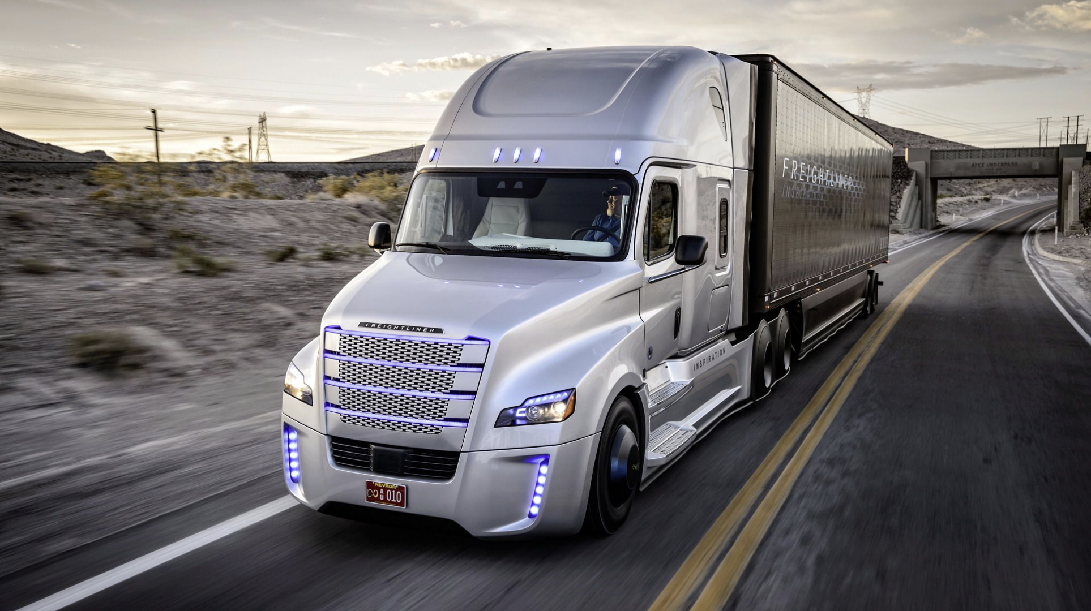
Thank you!
Matt Tabatabai
Email: mtabatabai@zuumapp.com
Phone: 800.410.1563
www.zuumapp.com

